Slide 1
ConvNet
Convolutional Network
S.Hemalatha
AP(S r.G)
Dept. Of Computer Applications
KEC

Slide 2
CNN
A Convolutional Neural Network (ConvNet or CNN) is a class of deep neural networks primarily used for analyzing visual data such as images or videos, where data patterns play a crucial role. .
advanced version of artificial neural networks (ANNs), primarily designed to extract features from grid-like matrix datasets.
CNNs are widely used in computer vision applications.
CNNs consist of multiple layers like the input layer, Convolutional layer, pooling layer, and fully connected layers.

Slide 3
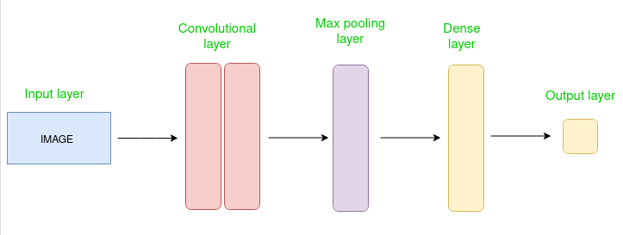
Architecture of CNN

Slide 4
Core Components and Layers of a ConvNet:
Input Layer:
This layer receives the raw input data, typically an image represented as a multi-dimensional array (e.g., height x width x color channels). (eg.image of dimension 32 x 32 x 3)
This layer holds the raw input of the image with width 32, height 32, and depth 3.
Convolutional Layer:
This is the fundamental building block of a ConvNet.
It applies a set of learnable filters (also called kernels) to the input volume. The filters/kernels are smaller matrices usually 2x2, 3x3, or 5x5 shape.
Each filter performs a convolution operation, sliding across the input and computing the dot product between the filter's weights and the corresponding input region.
This process extracts features like edges, textures, and patterns, generating feature maps that represent the presence of these features at different locations.
Activation Function (e.g., ReLU):
Typically applied after the convolutional layer.
It introduces non-linearity into the model, allowing it to learn more complex relationships in the data.
Rectified Linear Unit (ReLU) is a common choice, setting all negative values in the feature map to zero and keeping positive values unchanged.
Pooling Layer:
Its purpose is to reduce the spatial dimensions (height and width) of the feature maps, thereby decreasing computational complexity and the number of parameters.
Common pooling operations include Max Pooling (selecting the maximum value within a defined window) and Average Pooling (calculating the average value within a window).

Slide 5
Fully Connected Layer (FC Layer):
Located at the end of the network, after several convolutional and pooling layers.
The flattened output from the preceding layers is fed into this layer.
Each neuron in a fully connected layer is connected to every neuron in the previous layer, allowing the network to learn high-level representations and make predictions based on the extracted features.
Output Layer:
The final layer of the ConvNet.
It typically uses an activation function like Softmax for classification tasks, producing a probability distribution over the possible classes.
Additional Components:
Dropout Layer:
A regularization technique often used in fully connected layers to prevent overfitting by randomly deactivating a fraction of neurons during training.
Batch Normalization:
A technique to normalize the activations of a layer, which can improve training stability and speed.
This hierarchical structure allows ConvNets to automatically learn and extract increasingly complex features from raw visual data, making them highly effective for tasks such as image classification, object detection, and segmentation.

Slide 6
Detailed description of each layers
1. Input Layer
Purpose: Accepts raw image data (e.g., 224×224×3 for a color image).
Data shape: (Height × Width × Channels).
Example: For grayscale: 28×28×1, for RGB: 32×32×3.
2. Convolutional Layers
Core operation: Applies a set of learnable filters (kernels) to extract local features.
Key parameters:
Number of filters (e.g., 32, 64, 128…)
Kernel size (e.g., 3×3, 5×5)
Stride (step size of filter movement eg 1 or 2 or 3 etc)
Padding ("same" to preserve dimensions, "valid" to reduce)
Activation: Usually ReLU for non-linearity.
Outcome: Feature maps (spatial representation of learned features).
3. Pooling Layers
Purpose: Reduce spatial dimensions to lower computational cost and control overfitting.
Types:
Max Pooling: Keeps the largest value in each window.
Average Pooling: Takes the mean of values in the window.
Typical size: 2×2 with stride 2.
4. Dropout Layers (optional)
Purpose: Randomly "turns off" a fraction of neurons during training to prevent overfitting.
Typical rate: 0.25–0.5.
5. Fully Connected (Dense) Layers
Purpose: Flatten the feature maps into a vector and learn high-level representations. (nD to 1D)
Often uses ReLU activation, ending with a Softmax (for classification).
6. Output Layer
Purpose: Produces final predictions.
Activation:
Softmax for multi-class classification.
Sigmoid for binary classification.

Slide 7
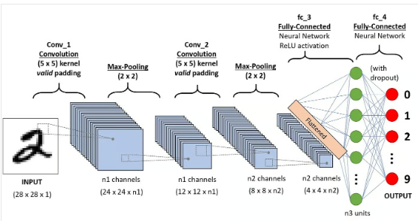
Architecture of the CNNs applied to digit recognition

Slide 8
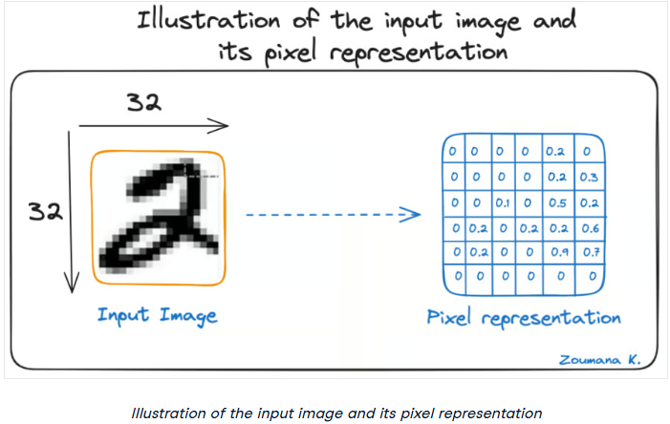

Slide 9
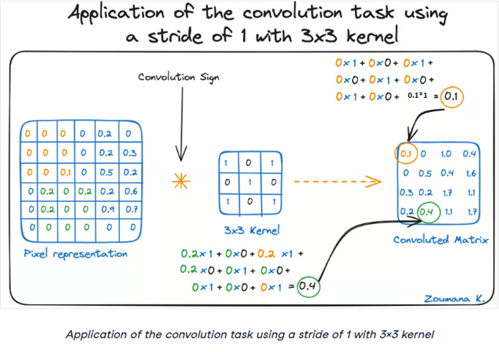
0.1*1

Slide 10
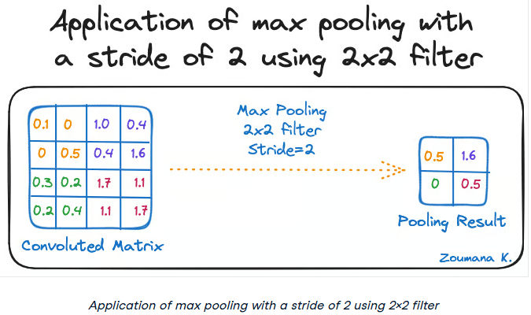

Slide 11
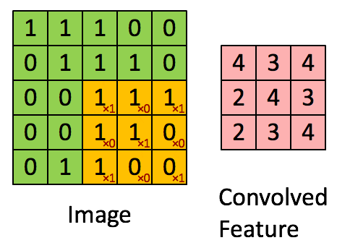
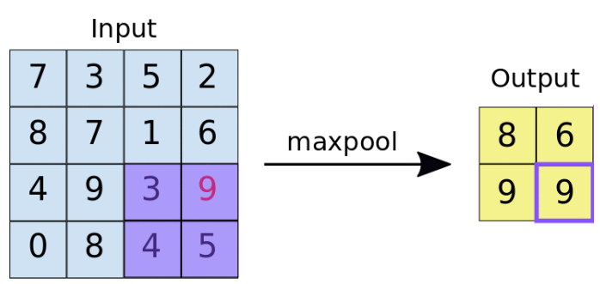
Convolution
Convolution- The term convolution refers to the mathematical combination of two functions to produce a third function.
Pooling- The objective of Pooling is to down-sample an input representation (image, hidden-layer output matrix, etc.), reducing its dimensions and allowing for assumptions to be made about features contained in the sub-regions created.
Pooling

Slide 12
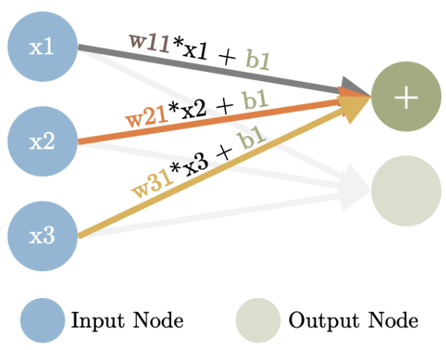
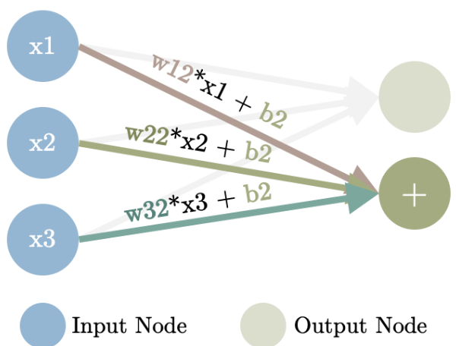
Fully Connected Layers- FCL in a neural network are those layers where all the inputs from one layer are connected to every activation unit of the next layer.

Slide 13
1. What is a Convolutional Layer?
A Convolutional Layer in a CNN applies small, trainable filters (also called kernels) over an input image (or feature map) to detect features such as edges, textures, shapes, etc.
2. Key Components
a) Filter (Kernel)
A small matrix of weights, e.g., 3×3 or 5×5.
Scans across the image, multiplying values element-wise and summing them up.
Each filter detects a specific pattern (e.g., vertical edges, curves).
One convolutional layer typically has many filters (e.g., 32, 64…).
b) Stride
How many pixels the filter moves at each step.
Stride = 1 → Filter moves one pixel at a time (more overlap, bigger output).
Stride = 2 → Filter moves two pixels at a time (less overlap, smaller output).
c) Padding
Decides what happens at the image borders:
Valid padding → No padding, output shrinks.
Same padding → Pads with zeros so output has the same spatial size as input.

Slide 14
3. How the Process Works
Example Input
A 5×5 grayscale image:
1 1 1 0 0
0 1 1 1 0
0 0 1 1 1
0 0 1 1 0
0 1 1 0 0
Filter (Kernel)
A 3×3 filter:
1 0 1
0 1 0
1 0 1
step-by-Step (Stride = 1, No Padding)
Place the filter on the top-left corner of the image.
Multiply each filter value with the overlapping image pixel.
Sum the results → This becomes one pixel in the output.
Slide the filter right by stride steps → Repeat until the end of the row.
Move down by stride steps and repeat for the next row.

Slide 15
First Position Calculation
Filter on top-left corner:
Image patch Filter Multiply & Sum
1 1 1 1 0 1 (1×1)+(1×0)+(1×1) +
0 1 1 × 0 1 0 = (0×0)+(1×1)+(1×0) +
0 0 1 1 0 1 (0×1)+(0×0)+(1×1)
= 1 + 0 + 1 + 0 + 1 + 0 + 0 + 0 + 1 = 4
So, the first output pixel = 4.

Slide 16


Output Size Formula
If:
n = input size
f = filter size
p = padding
s = stride
Then output size
Example: Input = 5×5, Filter = 3×3, Stride = 1, Padding = 0:
So output is 3×3.
4. Multiple Filters
If the layer has 32 filters, it produces 32 different feature maps (one per filter), stacked together as the output.

Slide 17
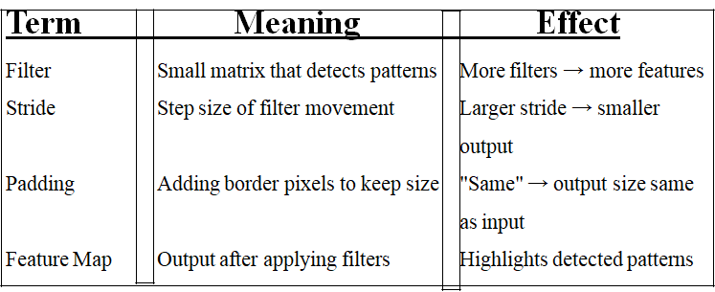

Slide 18
What is a Pooling Layer?
Purpose: Reduce spatial dimensions of feature maps while keeping important features.
Benefit: Fewer parameters → faster computation → less overfitting.
How: Applies a small window (e.g., 2×2) and replaces it with a single value.
use the same 5×5 matrix (after convolution) for pooling demonstration
4 2 1 0 3
3 1 2 3 4
1 0 1 2 3
0 1 3 4 2
2 3 0 1 1
Max Pooling
Operation: Take the maximum value in each window.
Pooling size: 2×2, Stride: 1, Padding: None

Slide 19
step-by-step:
First Output Row
(1,1) →
4 2
3 1
Max = 4
(1,2) →
2 1
1 2
Max = 2
(1,3) →
1 0
2 3
Max = 3
Output row → [4, 2, 3]
Second Output Row
(2,1) →
3 1
1 0
Max = 3
(2,2) →
1 2
0 1
Max = 2
(2,3) →
2 3
1 2
Max = 3
Output row → [3, 2, 3]
Third Output Row
(3,1) →
1 0
0 3
Max = 3
(3,2) →
0 1
3 4
Max = 4
(3,3) →
1 2
4 2
Max = 4
Output row → [3, 4, 4]
Final Max Pooling Output (Stride = 1)
4 2 3
3 2 3
3 4 4

Slide 20
Max Pooling with padding
Max Pooling with padding and stride = 2 for your same 5×5 feature map step-by-step.
Step 1: Add Padding
If we use 2×2 pooling with stride = 2 and want to cover all regions including borders, we can add zero padding around the matrix. We’ll pad 1 row/column on the bottom and right so pooling windows fit perfectly.
Padded matrix:
4 2 1 0 3 0
3 1 2 3 4 0
1 0 1 2 3 0
0 1 3 4 2 0
2 3 0 1 1 0
0 0 0 0 0 0
Size → 6×6

Slide 21
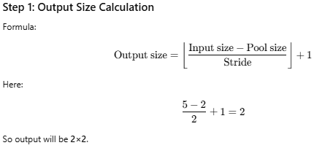
Max Pooling without padding
Pool size: 2×2
Stride: 2
Padding: None
for your same 5×5 feature map.

Slide 22
Step 2: Apply Max Pooling (2×2, stride=2)
Row 1 of Output
Window 1 (rows 1–2, cols 1–2):
4 2
3 1
Max = 4
Window 2 (rows 1–2, cols 3–4):
1 0
2 3
Max = 3
(No more columns for another 2×2 window.)
Row 2 of Output
Window 1 (rows 3–4, cols 1–2):
1 0
0 1
Max = 1
Window 2 (rows 3–4, cols 3–4):
1 2
3 4
Max = 4
(No more columns for another window.)
Final Max Pooling Output (stride=2, no padding)
4 3
1 4
So, compared to stride=2 with padding,
The output shrinks from 3×3 → 2×2
The bottom/right edges are ignored since no padding is added.
Assignment:
Try all four cases:
stride=1 no padding
stride=2 no padding
stride=1 with padding
stride=2 with padding
into one comparison chart so can see how output size and values change. That would make the differences very clear.

Slide 23
Average Pooling Global Pooling
Average Pooling
Operation: Take the average of all values in each window.
Example: Pool size = 2×2, Stride = 2.
First window:
4 2
3 1
Average = (4+2+3+1) / 4 = 2.5
Average pooling output:
2.5 1.5 3.5
0.5 2.5 2.5
2.0 1.0 1.5
Global Pooling
Global Max Pooling: Takes the maximum from the whole feature map (reduces entire map to 1 value per channel).
From our example → max = 4.
Global Average Pooling: Takes the mean of all values in the feature map.
From our example → sum all values / total count.
This is usually applied just before the output layer in place of a Flatten → Dense layer.

Slide 24
what happens between pooling layers and fully connected (dense) layers
How does the 2D matrix from pooling become the 1D vector that a fully connected layer expects?
Suppose after the last pooling layer, your output shape is:
4 × 4 × 64
Height = 4
Width = 4
Channels (feature maps) = 64
This is not yet suitable for a fully connected layer, because a Dense layer expects a 1D vector.
Flattening the Output
use a Flatten operation to convert the 3D tensor into a 1D vector.
Example:
Before Flatten: 4 × 4 × 64 Number of elements = 4 × 4 × 64 = 1024 After Flatten: [x₁, x₂, x₃, ..., x₁₀₂₄] → Shape: (1024,)
In frameworks:
Keras/TensorFlow: Flatten() layer
Feeding to Fully Connected Layer
Now the 1D vector becomes the input to the dense layer.
Each element of the vector is connected to every neuron in the FC layer.
If the first Dense layer has 128 neurons:
Input size = 1024 (from flattening)
Weight matrix size = (1024 × 128)
Bias size = (128)
Why Flatten Is Needed
Convolutional and pooling layers maintain spatial structure (H, W, Channels).
Fully connected layers treat inputs as simple feature lists — no spatial layout.
Flatten bridges the gap by reshaping without losing the learned feature values.
Pooling → Matrix Flatten → Vector Vector → FC layer for final decision-making.

Slide 25
Some common architectures of CNN
LeNet-5
AlexNet
VGG 16
Inception (GoogLeNet)
ResNet
DenseNet

Slide 26
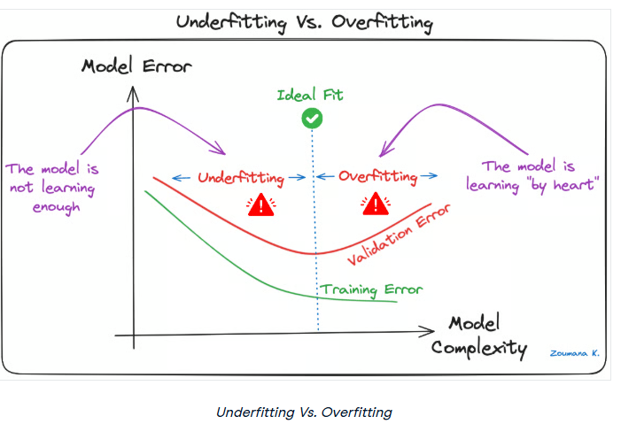

Slide 27
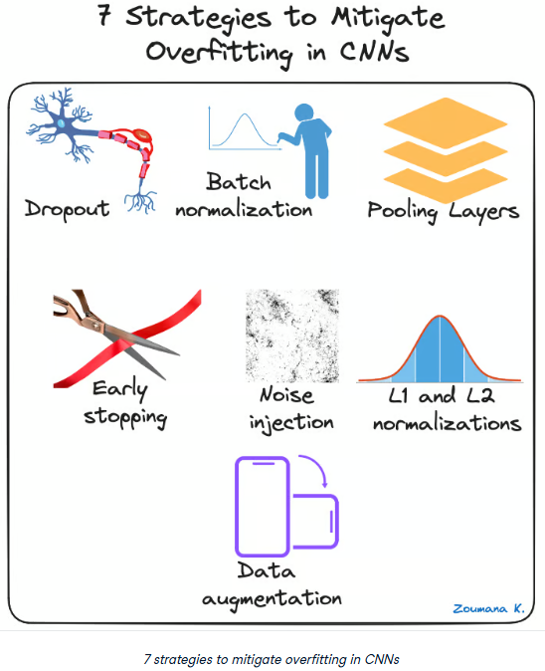

Slide 28
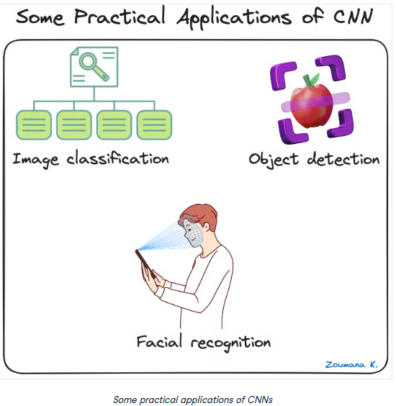

Slide 29

Deep Learning Frameworks for CNNs

